Slide 1
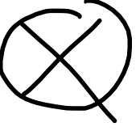
Tensor Product Vs. Kronecker Product

Slide 2

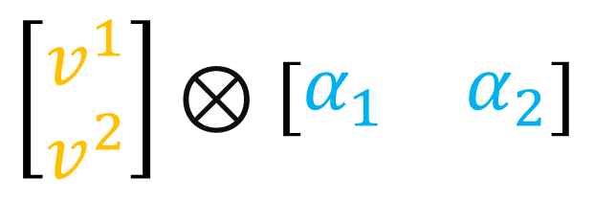
The $⊗$ symbol…
Tensor Product
(Tensors)
Kronecker Product
(Arrays)
$$\left[\begin{aligned}v^{1} \\ v^{2}\end{aligned}\right]⊗\left[\begin{matrix}α_{1} & α_{2}\end{matrix}\right]$$
$$\vec{e_{i}}⊗ε^{j}$$
Combines 2 tensors
into a new 3rd tensor.
Combines 2 arrays
into a new 3rd array.

Slide 3
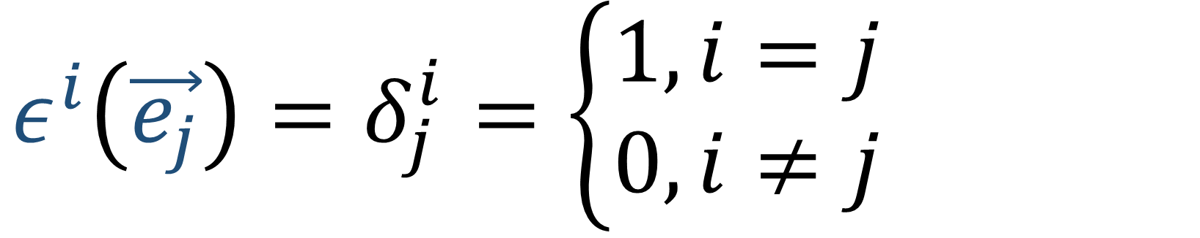


Basis for Vector Space $V$
$\vec{e_{1}},\vec{e_{2}}∈V$
Basis for Dual Space $V^{∗}$
$ε^{1},ε^{2}∈V^{∗}$
$$ε^{i}\left(\vec{e_{j}}\right)=δ_{j}^{i}=\left\{\begin{aligned}1, i=j \\ 0, i≠j\end{aligned}\right.$$

Slide 4


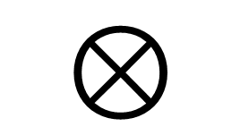

Tensor Product
$$\vec{e_{i}}$$
vector
$$\vec{e_{i}}⊗ε^{j}$$
$$⊗$$
linear map
$$ε^{j}$$
covector

Slide 5
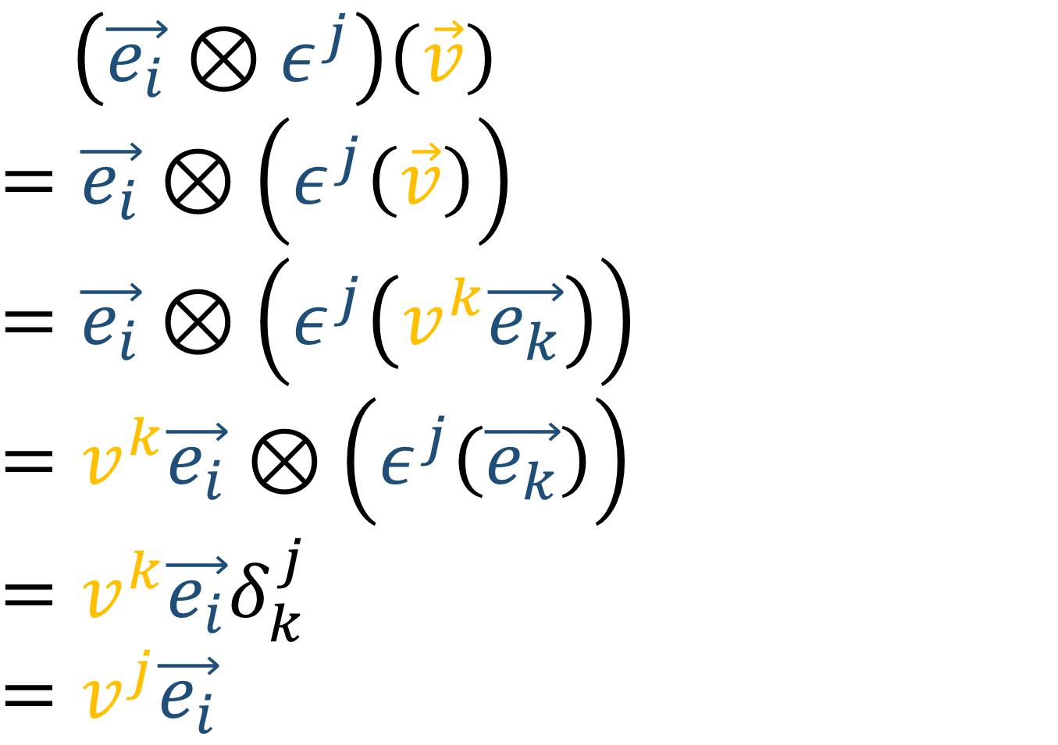
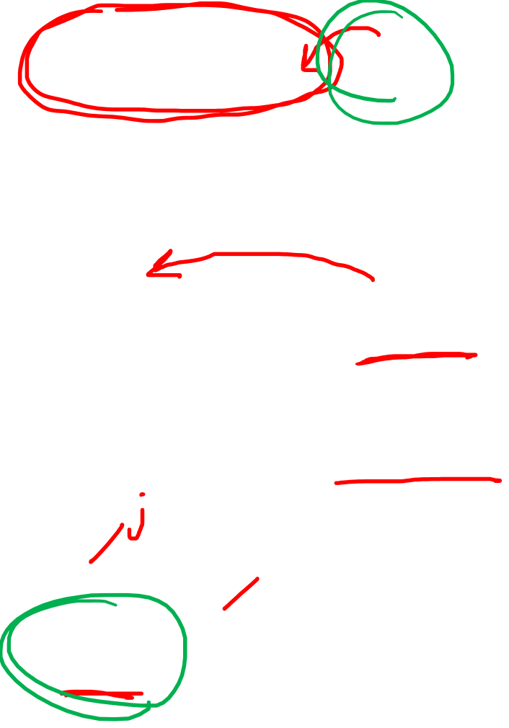
Tensor Product
$\left(\vec{e_{i}}⊗ε^{j}\right)\left(\vec{v}\right)$
$=\vec{e_{i}}⊗\left(ε^{j}\left(\vec{v}\right)\right)$
$$=\vec{e_{i}}⊗\left(ε^{j}\left(v^{k}\vec{e_{k}}\right)\right)$$
$$=v^{k}\vec{e_{i}}⊗\left(ε^{j}\left(\vec{e_{k}}\right)\right)$$
$$=v^{k}\vec{e_{i}}δ_{k}^{j}$$
$$=v^{j}\vec{e_{i}}$$

Slide 6
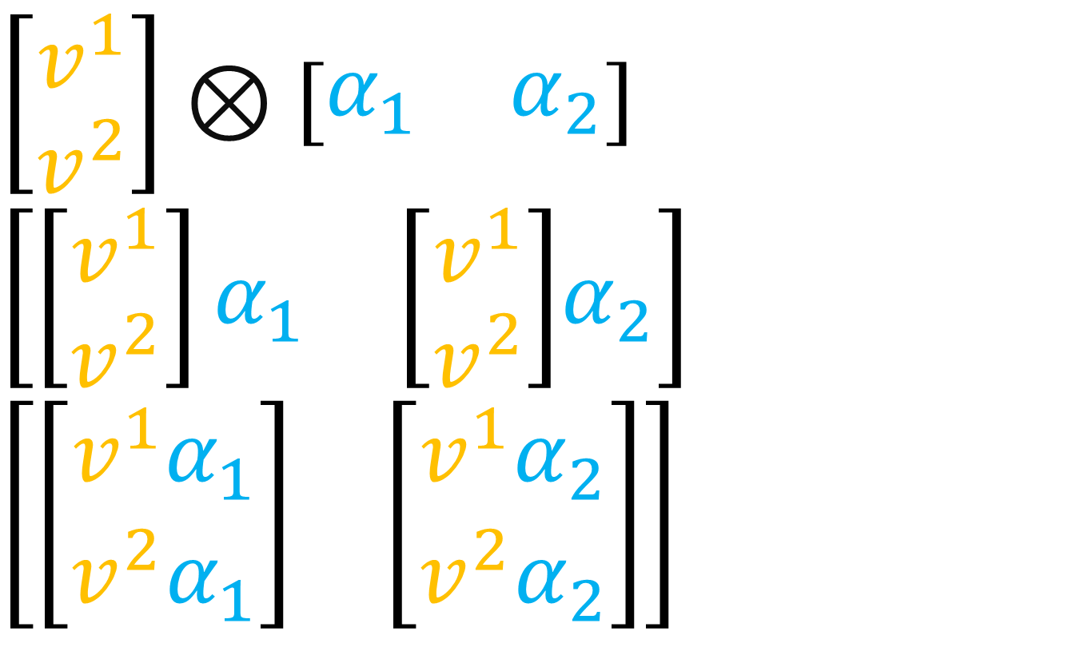

Kronecker Product
$$\left[\begin{aligned}v^{1} \\ v^{2}\end{aligned}\right]⊗\left[\begin{matrix}α_{1} & α_{2}\end{matrix}\right]$$
$$\left[\begin{matrix}\left[\begin{aligned}v^{1} \\ v^{2}\end{aligned}\right]α_{1} & \left[\begin{aligned}v^{1} \\ v^{2}\end{aligned}\right]\end{matrix}α_{2}\right]$$
$$\left[\begin{matrix}\left[\begin{aligned}v^{1}α_{1} \\ v^{2}α_{1}\end{aligned}\right] & \left[\begin{aligned}v^{1}α_{2} \\ v^{2}α_{2}\end{aligned}\right]\end{matrix}\right]$$

Slide 7
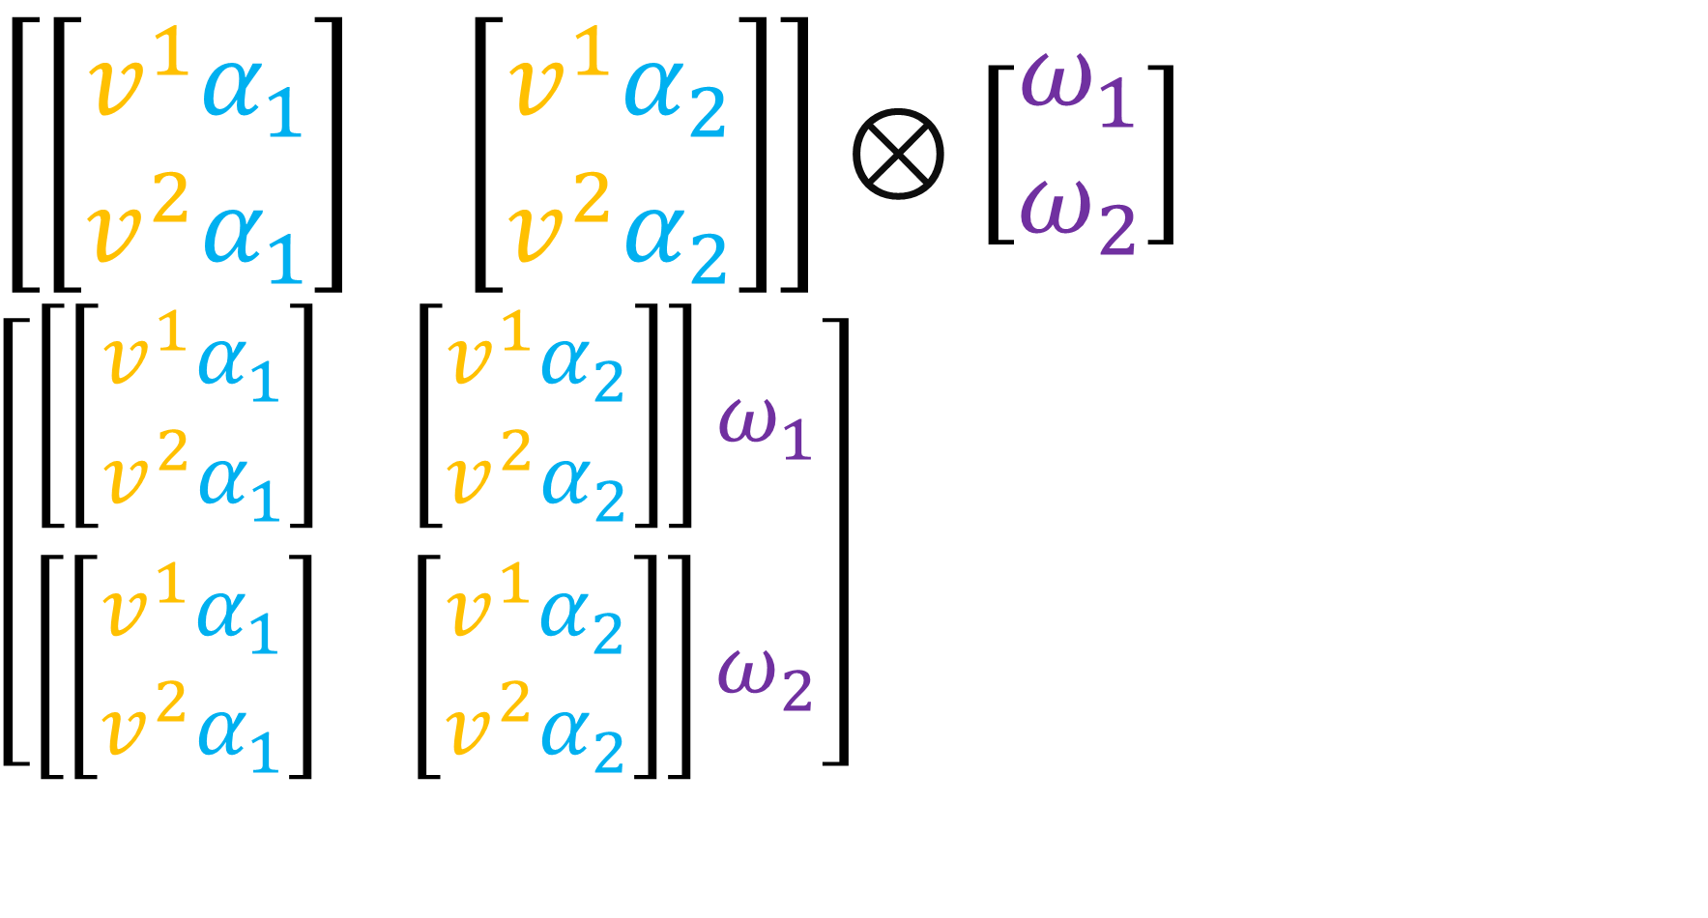
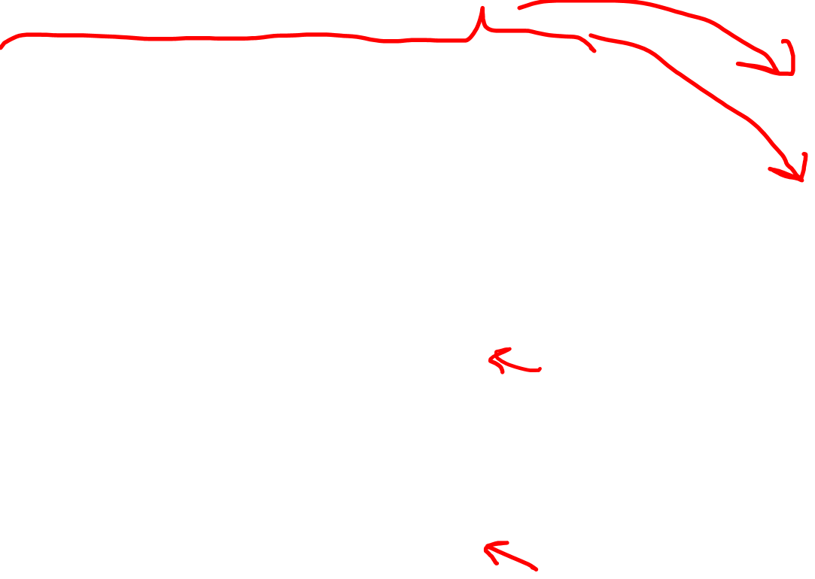

Kronecker Product
$$\left[\begin{matrix}\left[\begin{aligned}v^{1}α_{1} \\ v^{2}α_{1}\end{aligned}\right] & \left[\begin{aligned}v^{1}α_{2} \\ v^{2}α_{2}\end{aligned}\right]\end{matrix}\right]⊗\left[\begin{aligned}ω_{1} \\ ω_{2}\end{aligned}\right]$$
$$\left[\begin{aligned}\left[\begin{matrix}\left[\begin{aligned}v^{1}α_{1} \\ v^{2}α_{1}\end{aligned}\right] & \left[\begin{aligned}v^{1}α_{2} \\ v^{2}α_{2}\end{aligned}\right]\end{matrix}\right]ω_{1} \\ \left[\begin{matrix}\left[\begin{aligned}v^{1}α_{1} \\ v^{2}α_{1}\end{aligned}\right] & \left[\begin{aligned}v^{1}α_{2} \\ v^{2}α_{2}\end{aligned}\right]\end{matrix}\right]ω_{2}\end{aligned}\right]$$
$$\left[\begin{aligned}\left[\begin{matrix}\left[\begin{aligned}v^{1}α_{1}ω_{1} \\ v^{2}α_{1}ω_{1}\end{aligned}\right] & \left[\begin{aligned}v^{1}α_{2}ω_{1} \\ v^{2}α_{2}ω_{1}\end{aligned}\right]\end{matrix}\right] \\ \left[\begin{matrix}\left[\begin{aligned}v^{1}α_{1}ω_{2} \\ v^{2}α_{1}ω_{2}\end{aligned}\right] & \left[\begin{aligned}v^{1}α_{2}ω_{2} \\ v^{2}α_{2}ω_{2}\end{aligned}\right]\end{matrix}\right]\end{aligned}\right]$$

Slide 8
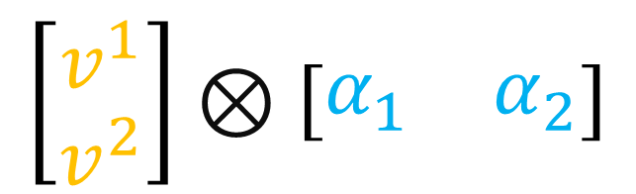
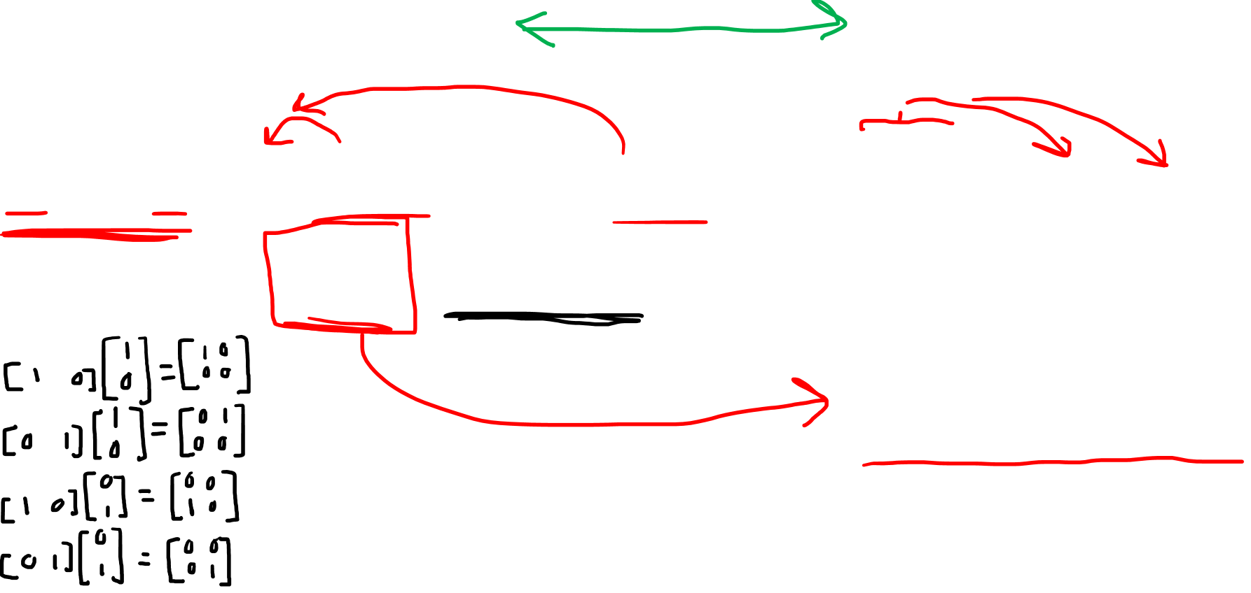
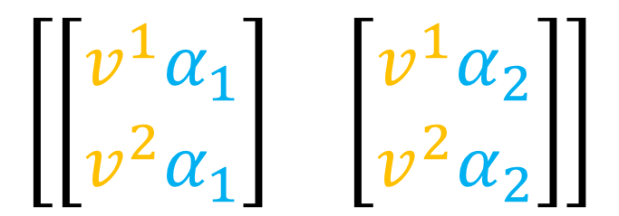
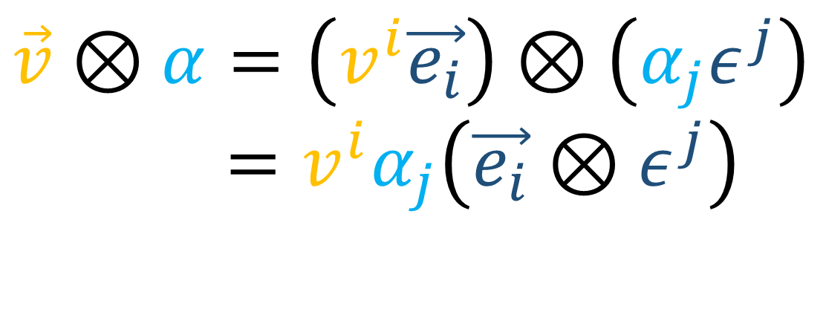
Tensor vs Kronecker Product
Tensor Product
(Tensors)
Kronecker Product
(Arrays)
$$\vec{v}⊗α=\left(v^{i}\vec{e_{i}}\right)⊗\left(α_{j}ε^{j}\right)$$
$$=v^{i}α_{j}\left(\vec{e_{i}}⊗ε^{j}\right)$$
$$\left[\begin{aligned}v^{1} \\ v^{2}\end{aligned}\right]⊗\left[\begin{matrix}α_{1} & α_{2}\end{matrix}\right]$$
$$\left[\begin{matrix}\left[\begin{aligned}v^{1}α_{1} \\ v^{2}α_{1}\end{aligned}\right] & \left[\begin{aligned}v^{1}α_{2} \\ v^{2}α_{2}\end{aligned}\right]\end{matrix}\right]$$

Slide 9
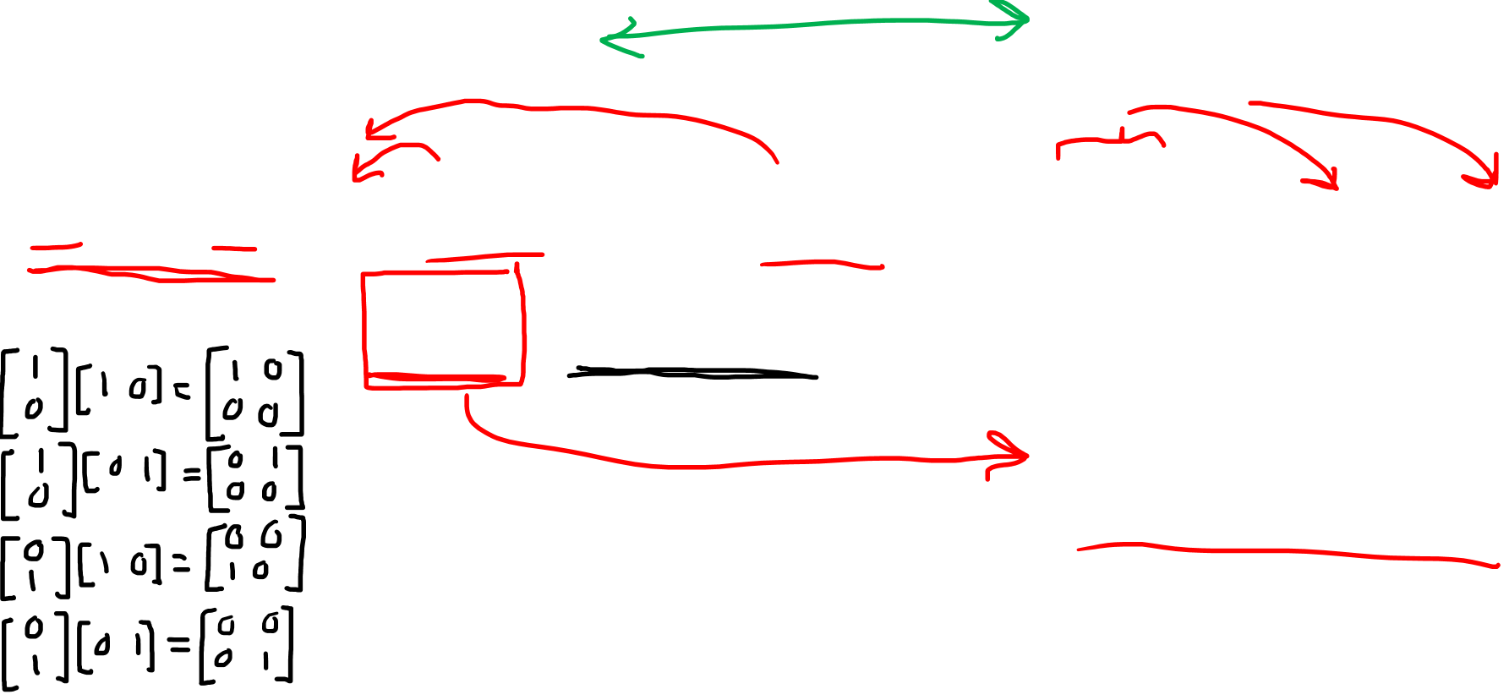
Tensor vs Kronecker Product
Tensor Product
(Tensors)
Kronecker Product
(Arrays)
$$\vec{v}⊗α=\left(v^{i}\vec{e_{i}}\right)⊗\left(α_{j}ε^{j}\right)$$
$$=v^{i}α_{j}\left(\vec{e_{i}}⊗ε^{j}\right)$$
$$\left[\begin{aligned}v^{1} \\ v^{2}\end{aligned}\right]⊗\left[\begin{matrix}α_{1} & α_{2}\end{matrix}\right]$$
$$\left[\begin{matrix}\left[\begin{aligned}v^{1}α_{1} \\ v^{2}α_{1}\end{aligned}\right] & \left[\begin{aligned}v^{1}α_{2} \\ v^{2}α_{2}\end{aligned}\right]\end{matrix}\right]$$

Slide 10
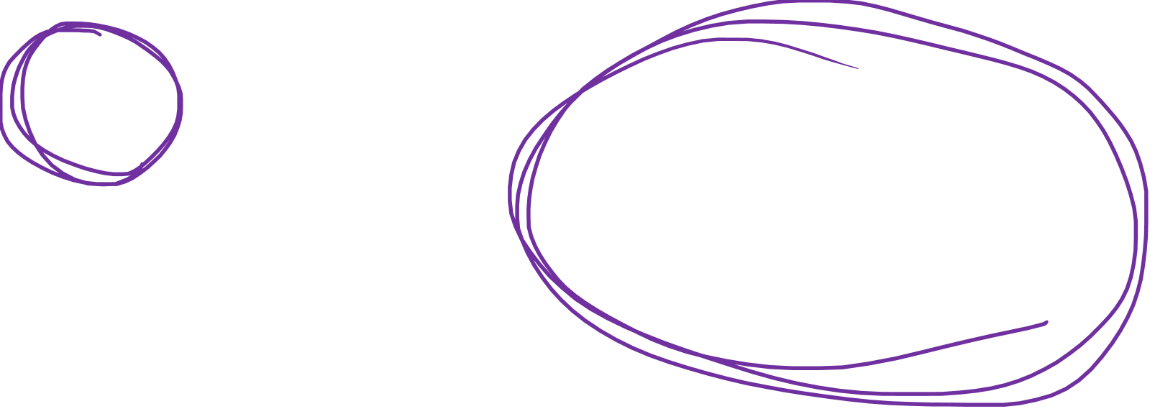
Tensor vs Kronecker Product
Tensor Product
(Tensors)
Kronecker Product
(Arrays)
$$\vec{v}⊗α=\left(v^{i}\vec{e_{i}}\right)⊗\left(α_{j}ε^{j}\right)$$
$$=v^{i}α_{j}\left(\vec{e_{i}}⊗ε^{j}\right)$$
$$\left[\begin{aligned}v^{1} \\ v^{2}\end{aligned}\right]⊗\left[\begin{matrix}α_{1} & α_{2}\end{matrix}\right]$$
$$\left[\begin{matrix}\left[\begin{aligned}v^{1}α_{1} \\ v^{2}α_{1}\end{aligned}\right] & \left[\begin{aligned}v^{1}α_{2} \\ v^{2}α_{2}\end{aligned}\right]\end{matrix}\right]$$

